Slide 1
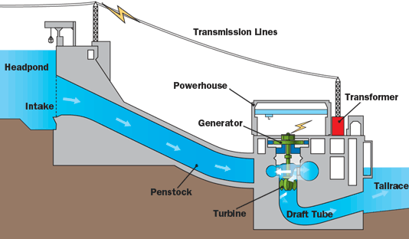
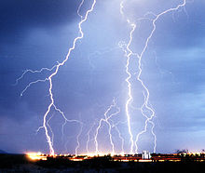
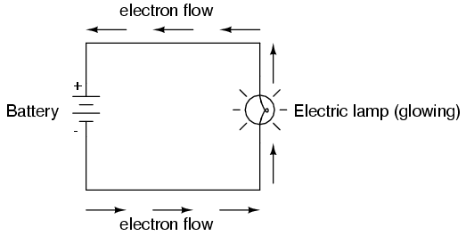
Electric Circuits Online Lab
Building circuits
Measuring Voltage (V)
Measuring Current (I)
Calculating Resistance (R)
Determine the effect of changing V, I and R on bulb brightness
Calculation practice

Slide 2
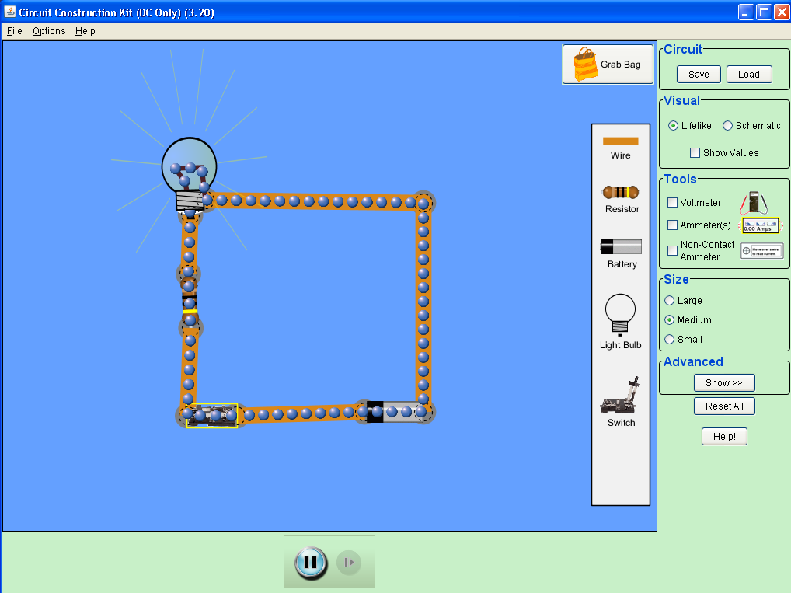
Online Circuits Simulator
Click on the picture below
Click on "Run Now"

Slide 3
Electric Circuits
Activity 1 –
To become familiar with the program create a chart like the chart below and include all of the items you can use in the program. (Hint: Don’t forget the grab bag)
Item | Circuit Element | Circuit Symbol | Function
Light bulb | Electrical Load |  | Converts electrical energy into light energy

Slide 4
Electric Circuits
Activity 2 –
Now lets practice using some of the circuit elements
Grab a wire by clicking and dragging it from the left.
Practice changing the shape (length and direction) of the wire by clicking and dragging on one end of the wire
Grab a battery
Attach the battery to the wire – Grab the end of the wire nearest the battery and move it to one of the ends of the battery and let go.
A connection is made when the circles at the end of the device appear shaded.

Slide 5
Electric Circuits
Check your connection by clicking and dragging the battery. If a connection is made, the wire will move with the battery to maintain the connection
Break the connection – Right click on the connection and select “Split Junction”

Slide 6
Electric Circuits
Activity 3 –
Now lets build a simple circuit. Use wires between each part of the circuit.
Connect a battery to a switch.
Connect the other end of the switch to a light bulb
Connect the other end of the light bulb to the free end of the battery
Draw a circuit diagram of your circuit.
Observe the brightness of the bulb.
Observe and record the direction of the electron flow.

Slide 7
Electric Circuits
Activity 4 –
Now we will learn how to use some of the measurement devices.
Start with the circuit you created in activity 3.
Add a voltmeter that measures the voltage across the battery
Break the connection between the battery and the switch. Add an ammeter in between them. (Note: You are not permitted to use the non contact ammeter.)
Record the current and the voltage.
Using Ohm’s Law, calculate the resistance of the light bulb.

Slide 8
Electric Circuits
Activity 5 –
Now lets learn how to change the properties of the objects we have selected.
Start over with the circuit you built in activity 3.
Changing the resistance – Right click on the light bulb.
Select “Change Resistance
Change the resistance to 5 Ω, 9 Ω
Observe and record the brightness of the bulb for each resistance.
Changing the voltage – Right click on the battery
Reset the battery to 0 Ω
Select Change Voltage
Change the voltage to 18 V, 3 V
Observe and record the brightness of the bulb for each voltage.
Fill in the chart on the next slide:

Slide 9
Activity 5
Resistance and Voltage of the Battery | Light Bulb Brightness (Rank 1-10; 10 = brightest)
5 Ω, 9V
9.0 Ω, 9V
0 Ω, 18 V
0 Ω, 3 V

Slide 10
Electric Circuits
Activity 6 –
Using what you learned in activities 4 and 5, create circuits to complete the chart below.
To verify Ohm’s Law, make sure the measured current matches the current calculated based on the given resistance and voltage.
Voltage | Resistance | Measured Current | Ohm’s Law Verified (Calculate the current)
18 V | 5 Ω
3 V | 5 Ω
18 V | 9 Ω
3 V | 9 Ω

Slide 11
Electric Circuits
Activity 7 – Exploring Series Circuits
Using the simulator create a circuit that has a switch, a battery and two light bulbs in series.
Use the default values for the battery voltage and for the light bulb resistance.
Complete the chart on the following slide for the following:
- Measure the current through the light bulbs.
- Measure the voltage across the individual bulbs.
- Make an observation of the brightness of the bulbs
Create a circuit with three light bulbs in series and repeat the above measurements.
Finally, disconnect one of the light bulbs, what affect does that have on the other bulbs?

Slide 12
Activity 7
Series Circuit with Two Light Bulbs in Simulator
 | Current | Voltage | Brightness
Battery
Light bulb 1
Light bulb 2
Light bulb 3
Series Circuit with Three Light Bulbs in Simulator
 | Current | Voltage | Brightness
Battery
Light bulb 1
Light bulb 2

Slide 13
Electric Circuits
Activity 8 – Exploring Parallel Circuits
Create a circuit with a battery, a switch and two light bulbs in parallel.
Use the default setting for the voltage of the battery and the resistance of the bulbs.
All answers should be placed in the chart on the following slide:
Measure the current through each of the light bulbs
Measure the current provided by the battery
Measure the voltage across the light bulbs
Make an observation of the brightness of each light bulb
Create a circuit with three light bulbs in parallel and repeat the observations.
Now disconnect on of the light bulbs. How does this affect the other bulbs?

Slide 14
Activity 8
Parallel Circuit with Two Light Bulbs in Simulator
 | Current | Voltage | Brightness
Battery
Light bulb 1
Light bulb 2
Parallel Circuit with Three Light Bulbs in Simulator
 | Current | Voltage | Brightness
Battery
Light bulb 1
Light bulb 2
Light bulb 3

Slide 15
Electric Circuits
Activity 9 – Solving Series and Parallel Circuits
All answers are to be included on the chart on the following slide
Solve the circuits you created in activities 7 and 8. Compare the measured current and voltage to the current and voltage predicted mathematically
Create the circuits below.
Circuit 1 – Two light bulbs in series. The first light bulb has a resistance of 10Ω and the second bulb has a resistance of 25 Ω.
Circuit 2 – The same light bulbs above in parallel
Circuit 3 – Three light bulbs (10 Ω, 15 Ω and 20 Ω) in series
Circuit 4 – The same three light bulbs in parallel

Slide 16
Activity 9
# | Description | Voltage measured | Current Measured | Voltage/Current calculated
1 | Two light bulbs in series. The first light bulb has a resistance of 10Ω (R₁)and the second bulb has a resistance of 25 Ω (R₂). | V₁= V₂= V_{B}= | I= | V₁= I R₁ V₂= I R₂
2 | The same light bulbs above in parallel | V₁= V₂= V_{B}= | I₁= I₂= | I₁= V₁ / R₁ 1₂= V₂ / R₂
3 | Three light bulbs (R₁ =10 Ω, R₂=15 Ω and R₃ =20 Ω) in series. | V₁= V₂= V₃= V_{B}= | I= | V₁= I R₁ V₂= I R₂ V₃= I R₃
4 | The same three light bulbs in parallel | V₁= V₂= V₃= V_{B}= | I₁= I₂= I₃= | I₁ = V₁ / R₁ I₂ = V₂ / R₂ I₃= V₂ / R₂

Slide 17
Electric Circuits
Activity 10 – Power and Energy
All answers are to be written in the chart on the following slide
Create a circuit with a battery, a switch and two light bulbs in parallel.
Measure the voltage across the battery and the current through the battery.
Determine the power used by the circuit
Measure the voltage across the light bulbs and the current through the light bulbs and determine the power used by each bulb.
Repeat the above measurements and calculations for a series circuit with two light bulbs.

Slide 18
Activity 10
Description | Voltage measured | Current Measured | Power calculated (P=IV)
Two light bulbs in parallel | V₁= V₂= V_{B}= | I₁= I₂= I_{B}= | P_{1,2} = I₁V₁ P_{B}= I_{B}V_{B}
Two light bulbs in series. | V₁= V₂= V_{B}= | I₁= I₂= I_{B}= | P_{1,2}= P_{B}=
Three light bulbs in series | V₁= V₂= V₃= V_{B}= | I₁= I₂= I₃= I_{B}= | P_{1,2,3}= P_{B}=
Three light bulbs in parallel | V₁= V₂= V₃= V_{B}= | I₁= I₂= I₃= I_{B}= | P_{1,2,3}= P_{B}=

Slide 19
Electric Circuits
Activity 11 – Wiring Batteries
Answers should be included in the chart on the following slide
Create a circuit that has two batteries in series, a switch and a light bulb. Use default setting for all devices.
Measure the current through the batteries as well as the voltage across the batteries
Make an observation of the brightness of the bulb.
Measure the voltage across just one battery. Use this voltage to determine the power being used by that battery.
Repeat the above observations for a circuit with the two batteries in parallel.

Slide 20
Activity 11
 | Two batteries in Parallel | Two batteries in Series
Voltage of 2 batteries:
Current of 2 batteries:
Brightness of bulb:
Voltage for one battery:
Power for one battery:

Slide 21
Electric Circuits
Fill in the following chart which looks at the advantages, disadvantages and practical applications of each.
Circuit type | Advantages | Disadvantages | Practical Applications
Batteries in Series
Batteries in Parallel

Slide 22
Electric Circuits
Activity 12 – Solving Circuits
Look at the circuits on the following slides.
Solve the circuits calculating the voltage, current and any unknown resistances.
**RT Series = R1 + R2 + … + Rn → simply add the resistances found in the circuit
**RT Parallel =
Build the circuit on the simulator and make all measurements to verify your calculations.

Slide 23
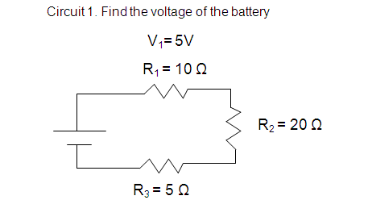
Circuit 1

Slide 24
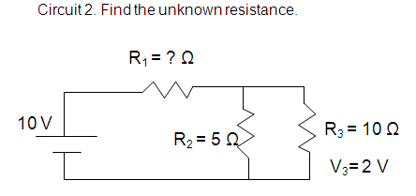
Circuit 2

Slide 25
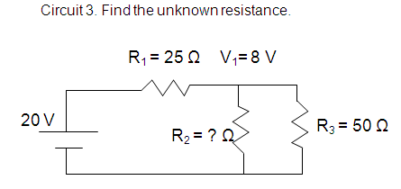
Circuit 3

Slide 26
Go to the following website and solve the given circuits
Click Here

